Slide 1



Patient Care Coordination Tone Southerland, Greenway Medical Technologies Laura Heermann Langford, Intermountain Healthcare
Webinar Series 2013
http://ihe.net/Webinars/

Slide 2
PCC Domain Update Agenda
Domain & Committee Overview
Domain Profiles & Technical Frameworks
Overview Profiles developed
New Profiles developed in 2012-2013 year
How to Participate?
IHE International Membership
Planning & Technical Committees
Q&A Session

Slide 3
Patient Care Coordination (PCC) Overview
Scope
Integration issues that cross providers, patient problems or time.
General clinical care aspects such as document exchange, order processing and coordination with other specialty domains.
Workflows and integration needs that are common to multiple specialty areas.
Sponsors
Health Information Management Systems Society (HIMSS)
American College of Physicians (ACP)
Countries involved in committees
United States
Canada
Italy
France
Netherlands

Slide 4
History and Roadmap
History
IHE PCC was formed in May of 2005
The committee’s first profile was also IHE’s first content profile: XDS-MS. The profile was delivered in September of 2005 for Trial Implementation.
Since then, PCC has created over a dozen content profiles, several workflow profiles, and several integration profiles supporting clinical decision support.
The IHE PCC Technical Framework is used in national programs in the US, France, the EU and Asia.
Road Map
Nursing
Pediatric Care
Long Term Care
Harmonization with other content standards
Notes:
History:
US: MU – any others?
EU: epSOS
France: national health record
Asia: which programs?
Harmonization:
Consolidated-CDA

Slide 5
Profiles & Technical Frameworks
Overview
IHE Technical Frameworks
http://ihe.net/Technical_Frameworks/#pcc
IHE Profiles developed by PCC
http://wiki.ihe.net/index.php?title=Profiles#IHE_Patient_Care_Coordination_Profiles
Learn More todo: change these links
2013 Webinar Series-http://www.ihe.net/Events/webinars2012.cfm
2011 Webinar Series- http://www.ihe.net/Events/webinars2011.cfm
2010 Webinar Series- http://www.ihe.net/Events/webinars2010.cfm
2009 Webinar Series- http://www.ihe.net/Events/webinars2009.cfm
2008 Webinar Series- http://www.ihe.net/Events/webinars2008.cfm
Notes:
Wiki link to profiles is out of date

Slide 6
Profiles & Technical Frameworks
Existing Profiles with High Uptake
Medical Summaries (XDS-MS)
Discharge and Referral Summaries exchanged between providers
EHR and HIS solutions
Ensures adequate exchange of data for referrals and transitions of care between inpatient and ambulatory settings.
Exchange of Personal Health Records (XPHR)
Exchange Clinical Summary data with patients
EHRs, PHRs, Patient Portals
Ensures that patients have updated lists of healthcare providers, problems, medications, allergies, immunizations, lab results, procedures and encounters

Slide 7
Profiles & Technical Frameworks
Existing Profiles for Clinical Decision Support
Query for Existing Data (QED)
Access to clinical data (problems, medications, allergies, results, procedures, encounters)
EHR, CDR, HIS, Registries
Provides access to clinical data for use in quality measurement, reporting, clinical decision support, and research
Care Management (CM)
Supports communication to specialized care delivery systems for disease management
Request for Clinical Guidance (RCG)
Access to Clinical Decision Support
EHR, other HIT Systems
Provides standardized interface to access clinical decision support as a service
Retrieve Clinical Knowledge (RCK)
How Health IT systems, Personal Health Records, and HIEs can retrieve clinical knowledge on a topic suitable for presentation to a clinician or patient

Slide 8
Profiles & Technical Frameworks
Existing Profiles for Emergency Care
Emergency Department Referral (EDR)
Enhances XDS-MS to support “Heads-up” call to ED
EHR, EDIS, HIS, HIE
Provides critical data needed in ED visits
Emergency Department Transport Summary (ETS)
Interfacility Transport Summary (ITS)
Emergency Department Encounter Summary (EDES)
Documents care in an ED encounter
EHR, EDIS, other HIT Systems
Provides critical information for patients and providers after an ED visit.

Slide 9
Profiles & Technical Frameworks
Existing Profiles for Nursing, Maternal Care and others
Obstetric Care
Antepartum H&P (APHP)
Antepartum Summary (APS)
Antepartum Laboratory (APL)
Antepartum Education (APE)
Labor and Delivery H&P (LDHP)
Labor and Delivery Summary (LDS)
Maternal Discharge Summary (MDS)
Postpartum Visit Summary (PPVS)
Newborn Discharge Summary (NDS)
Perinatal Workflow (PW)
Nursing
eNursing Summary (ENS)
Patient Plan of Care (PPOC)
Implementation Priorities for IHE Nursing Subcommittee White Paper
Immunizations
Immunization Content (IC)
Reconciliation (RECON)
Reconciliation of Diagnoses, Allergies and Medications

Slide 10
Profiles & Technical Frameworks
Existing Profiles for Workflow
Cross Enterprise Basic eReferral Workflow Definition (XBeR-WD)
Builds upon ITI XDW to manage the workflow related to an eReferral.
GP/Specialist EHR, HIS
Trial Implementation
Cross Enterprise TeleHome Monitoring (XTHM)
Builds upon ITI XDW to manage the clinical process involving chronic patients followed by telemonitoring services.
GP/Specialist EHR, Telemonitoring center
Trial Implementation

Slide 11
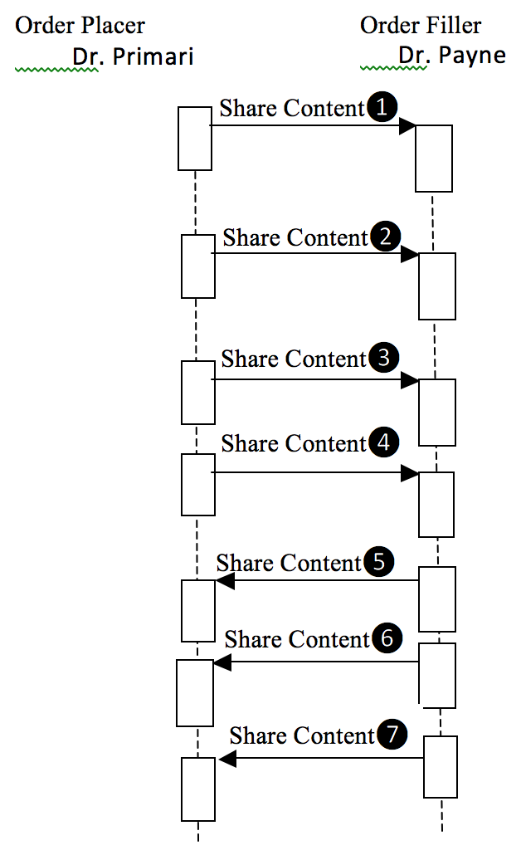
Profiles & Technical Frameworks
New Profiles in Development – Content??
Referral and Order Linking (ROL)
Makes use of new actor(s) (order placer, order filler?) to link referrals created in disparate systems
Includes use cases across a variety of health care settings
PCP/Specialist, HIS, Public Health
Trial Implementation

Slide 12
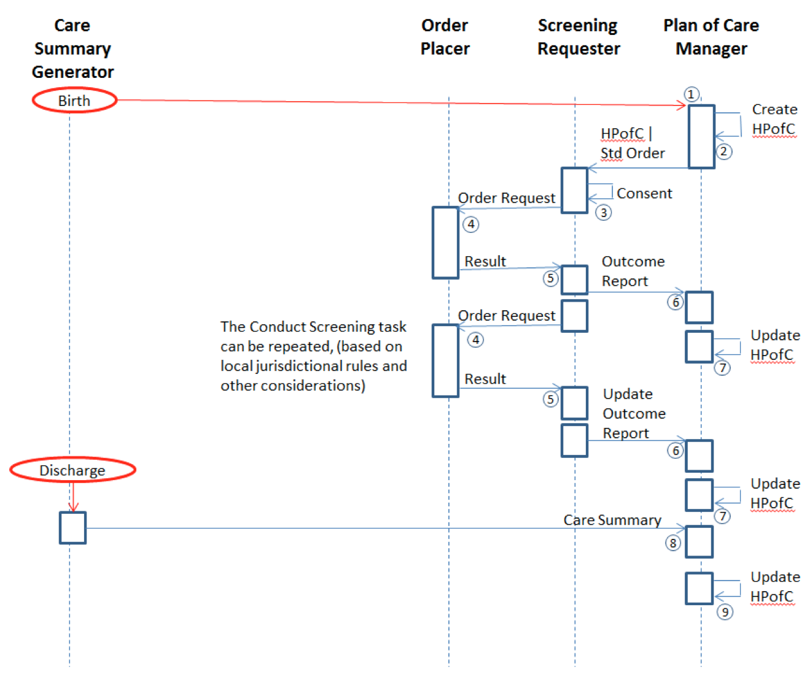
Profiles & Technical Frameworks
New Profiles in Development - Workflow
Early Hearing Detection and Intervention (EHDI)
Builds upon ITI XDW to manage the workflow related to early hearing screenings for newborns.
HIS, Public Health, PCP
Improve health outcomes for children at risk for hearing loss
Trial Implementation

Slide 13
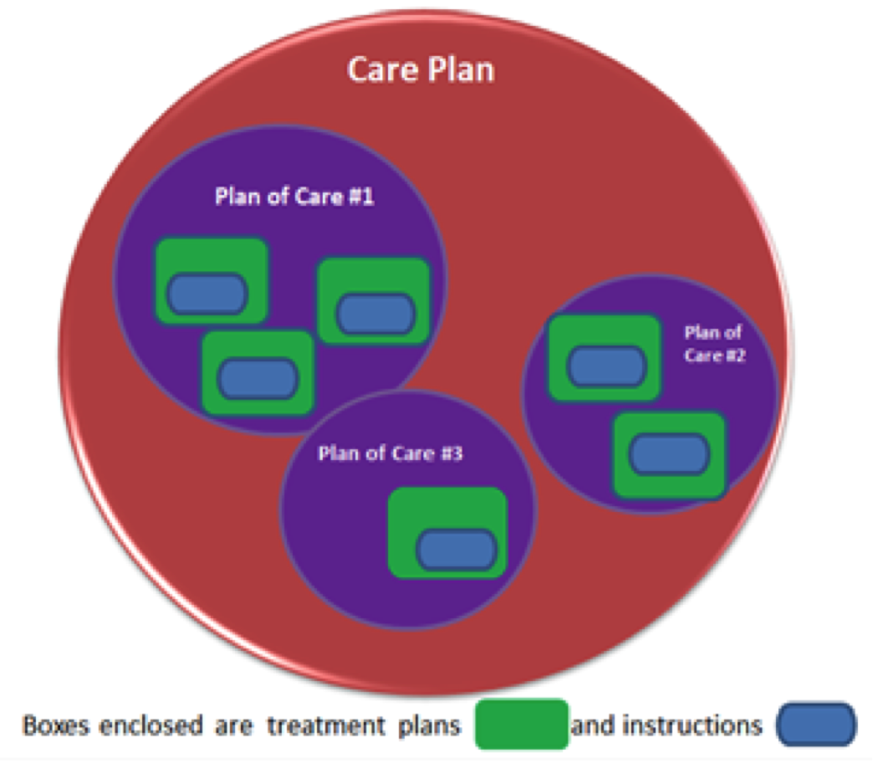
Profiles & Technical Frameworks
New Profiles in Development - Nursing
Patient Centered Care Plan (PtCP)
Content profile defining a centralized care plan to meet the needs of many stakeholders
Creates opportunity for reconciliation/consolidation of disparate care plans
Trial Implementation
Notes:
PPOC = Patient Plan of Care
eNS = eNursing Summary

Slide 14
Profiles & Technical Frameworks
New Profiles in Development - Content
C-CDA Harmonization (CDAH)
Harmonization US based C-CDA w/existing IHE PCC Templates
Vocabulary Binding
Template Versioning
Compatibility w/existing implementations
Additional Public Comment anticipated October 2013

Slide 15
How to Participate in PCC
IHE International Membership is Free.
Apply for IHE International Organizational Membership
Visit: www.ihe.net/join
Review IHE's 400+ Organizational Members
Participate in IHE Domains & Committees
IHE Organizational Members only
12 Clinical and Operational Domains
Each Domain has one planning and one technical committee
Non-members participate in comment periods and implement IHE Technical Frameworks

Slide 16
PCC Planning Responsibilities
Planning Committee
Recruitment
Education
Review IHE Profiles Proposals
Identifies committee priorities and problems
Planning for 2013-2014
Committee Roadmap
Contact Information
ihe@himss.org
Co-chair: Laura Heermann Langford
Co-chair: Tone Southerland
pccplan@googlegroups.com
IHE.net page:http://www.ihe.net/Patient_Care_Coordination/
Wiki page: http://wiki.ihe.net/index.php?title=Patient_Care_Coordination_Planning_Committee

Slide 17
PCC Technical Responsibilities
Technical Committee
Recruitment
Development of IHE Profiles
Maintenance of IHE Technical Frameworks
Projects:
Referral and Order Linking (ROL)
Early Hearing Detection and Intervention (EHDI)
Patient Centered Care Plan (PtCP)
cCDA Harmonization (CDAH)
Incoming profile development
Contact Information
ihe@himss.org
Co-chair: Emma Jones
Co-chair: Laura Bright
pcctech@googlegroups.com
IHE.net page:http://ihe.net/Patient_Care_Coordination/
Wiki page:http://wiki.ihe.net/index.php?title=Patient_Care_Coordination_Technical_Committee

Slide 18
How to Participate in PCC?
Participate IHE’s Profile Cycle
Committee work follows the IHE Profile Cycle
Annual eighteen (18) month cycle
Each IHE domain has independent schedule
Opportunities for IHE members and non-members to participate in cycle
Detailed overview of IHE Cycle next

Slide 19


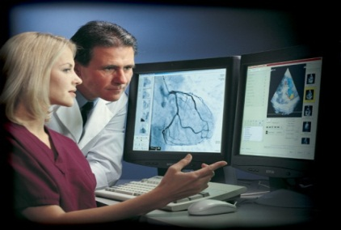
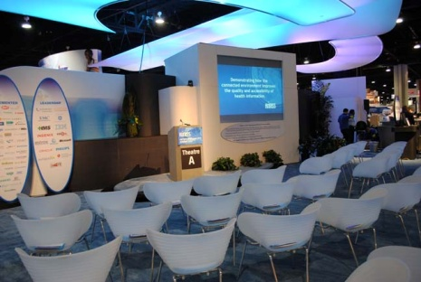

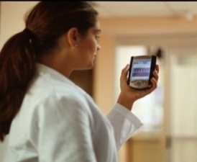
IHE Profiles Drafted & Revised
Test at IHE Connectathons
Trial
Implementation
Posted
Publish in IHE’s Product Registry
Published
For Public
Comment
months 14-18
Demonstrate at a
IHE Technical
Framework Developed
months 6-13
Profile Selection by Committees
IHE Improves, Safety, Quality and Efficiency in Clinical Settings
Install Interoperable products in Clinical Settings worldwide
IHE Call for Proposals Opens
months 1-5

Slide 20
IHE Profile Cycle Stages | Participation Status | Open Date | Close Date | Learn More
Call for Proposal | Open | July 29, 2013 | September 29, 2013 | ftp://ftp.ihe.net/Patient_Care_Coordination/Templates/IHE_Profile_Proposal_Template-Brief.docx
Profile Selection | Closed | October 9-10, 2013 | November 12-13, 2013 | http://bit.ly/IHEPCCPlan
IHE Profiles drafted in IHE Committees | Closed | January 2014 | May 2014 | http://bit.ly/IHEPCCTech
Public Comment 1 | Open | June 2014 | July 2014 | IHE.net- Documents now in PC IHE’s Wiki- PC Process explained
Trial Implementation Published | Open | N/A | July 2014 | http://bit.ly/IHEPCCTF
IHE Connectathon Registration | Open | August 2014 | Fall 2014 | IHE N.A. Connectathon Registration
IHE Connectathon Dates | Open | Jan-Feb 2015 | Jan-Feb 2015 | IHE N.A. Connectathon
http://wiki.ihe.net/index.php?title=Patient_Care_Coordination
Notes:
Update this slide….

Slide 21
Thank you for your attention
Questions?

Slide 22
Learn More about IHE International
Important Links and Information
All webinar recordings and slide decks will be posted online at: http://ihe.net/Webinars/
Sign up for the IHE International News
Email secretary@ihe.net
Apply for IHE International Membership
Visit: http://ihe.net/Join/

Slide 23
Learn More about IHE Connectathons
IHE International Connectathons: http://ihe.net/Connectathon/
IHE N.A. Connectathon is January 27-January 31, 2014
Read more: http://www.iheusa.org/connectathon.aspx
IHE N.A. Connectathon Registration Opens: September 23- September 30, 2012
View the Participant Guidelines online: http://www.iheusa.org/connectathon-participantresources-guidelines.aspx
Notes:
Update this slide…

